Slide 1
Study on Influence of Organic Farming in Adoption of Climate Change
M.L.Yadav
Madhyanchal Forum

Slide 2
Study on Influence of Organic Farming in Adoption of Climate Change
To popularize the result & success of organic farming in Adoption of climate change, this Study is conducted By Madhyanchal forum through its partners, active in 14 block of 9 districts.
The objectives:-
To study the effect of climate change on agriculture and its impact on society.
To discuss negative effect of climate change on farming and ways of its adoption.
To study Impact of organic farming in mitigation of climate change.
Regional level consultation to develop a common understanding & approach
Documentation to Submit in State level & National level consultation to decide a common pathway.
Influence of Organic Farming

Slide 3
Participating organizations
Sn | Participating Organization | Area cover | Villages covered | No of Farmers Studied | No of farmers attended workshop
1 | Adiwasi Sewasram Trust | Badwah | 7 | 25 | 50
2 | Adiwasi Chatna Shiksha Sewa Samiti | Jhabua Ranapur | 6 | 25 | 55
3 | Bhartiya Vidhya Pracharini Sabha | Mhow (Ghat Section) | 4 | 25 | 73
4 | Madhyanchal Forum | Indore, Khargoun, Badwani, Dewas | 17 | 25 | 54
5 | Mahila Sanchetna | Tarapur umarban | 15 | 25 | 65
6 | New life Centre | Ratlam | 4 | 25 | 55
7 | Rural Development Institude | Garoth | 7 | 25 | 50
8 | Prasoon | Pathari Basoda | 5 | 25 | 34
9 | Vikas Anusandhan Avam Shekshanik pragati Sansthan | Indore (Malwa region) | 11 | 25 | 68
Total |  |  | 76 | 225 | 504
Influence of Organic Farming

Slide 4
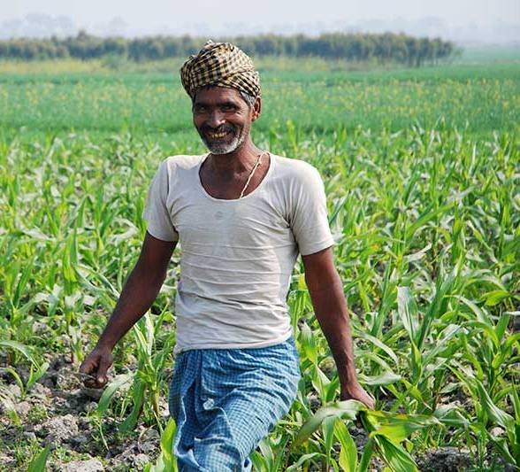
Respondents (farmers)
Age Group
25 To 40 years – 30%
41 to 55 years – 45%
56 to 75 years – 25%
Holdings
Small Farmers – 80%
Big Farmers – 20%
Farming Experience
Ancestral - 75%
Up to 10 years – 25%
Practicing Organic Farming
5 to 10 years – 70%
Below 5 years – 30%
Influence of Organic Farming

Slide 5
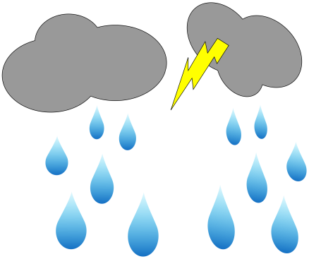
CLIMATE BEFORE THE YEAR 1980
Season of full 4 months
Influence of Organic Farming

Slide 6
CLIMATE BEFORE THE YEAR 1980
RainS – 75 to 90 days
Winter – 120 days
Summer-120 days
Winter rains in nov-dec
Influence of Organic Farming

Slide 7
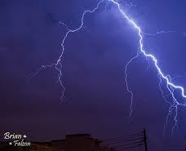
CLIMATE BEFORE THE YEAR 2000
4 month
3 month
3 month
reduced to 3 months
Influence of Organic Farming

Slide 8
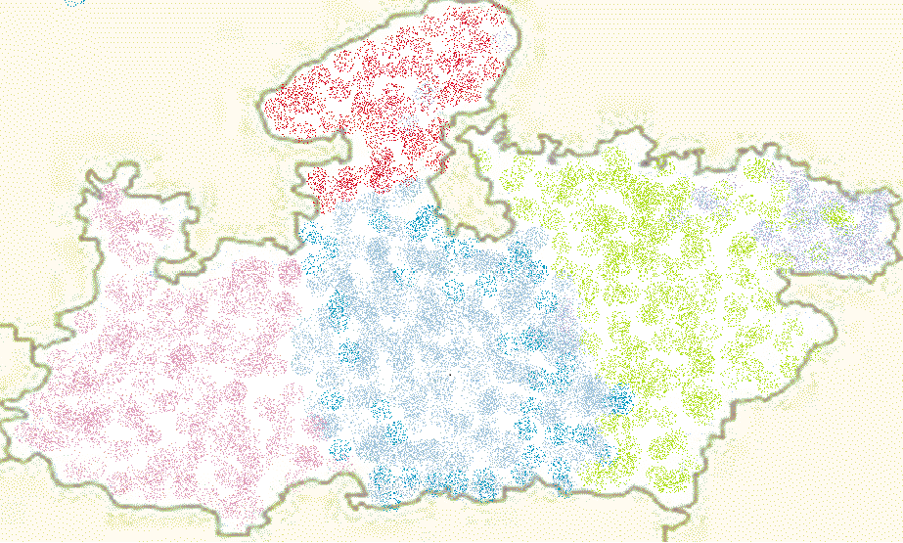
CLIMATE BEFORE THE YEAR 2000
RAINS – 60 TO 75 DAYS
WINTER – 90 DAYS
SUMMER-120 DAYS
WINTER RAINS IN DEC-JAN
Influence of Organic Farming

Slide 9
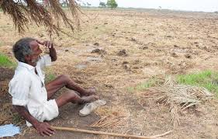
Present situation
Rainy days reduced to less than 45 day.
Cold Waves reduced to less than 40 days.
Hot days (More than 40⁰C) through out Summer season.
Daily temperature remains more than normal through out the year.
Irregular, uncertain & scattered rain fall.
Section & untimely rains became beyond belief.
Untimely & irregular cold waves with low intensity.
Natural calamities – hail storm, flood, drought, low rainfall etc.
high rainfall became regular phenomena.
Untimely winter rains & gauze.
Influence of Organic Farming

Slide 10
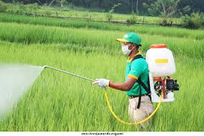
Change in the farming practices
Maximum use of Machinery.
Use of hybrid & B.T./ GM seeds.
Hastiness in sowing.
Maximum use of chemicals fertilizers
Maximum use of chemical based insecticide, pesticides & herbicides.
Low interest in animal keeping.
Minimum or no use of organic manure.
Deforestation & cultivation on maximum land available.
Influence of Organic Farming

Slide 11
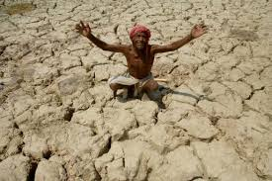
Effect on agriculture
Soil fertility – Reduced.
Water table - Drawdown.
Intensity of insect, pest & diseases in the crop – Increased.
Production of crop – Reduced.
Cost of crop production – increased.
Biodiversity – Unbalanced.
Living soil - Dead.
Sustainability of agriculture – Doubtful.

Slide 12
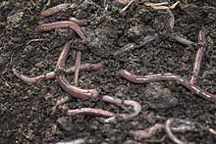
Organic farming practices for adoption of climate change
Highest priority to improve soil condition by using indigenous methods in soil preparation.
Maximum use of organic manure to improve humus in the soil.
Use of improved methods of composting.
Preparation of crop calendar & adoption of crop rotation practices.
Use of organic insecticide, organic & herbal preparation for crop protection.
Use of crop residues in preparation of organic manure.
Compulsory inclusion of animal husbandry.
Influence of Organic Farming

Slide 13
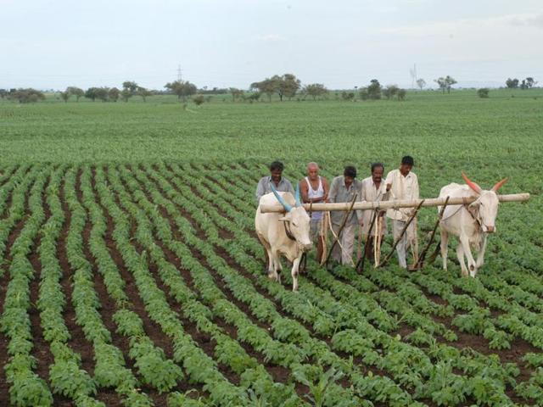
Impact of Organic farming practices
Dead soil - Revived.
Soil condition & Soil humus - Improved.
Germination of seed & growth of crop - Improved
Survival of crop under adverse condition - Improved.
Crop production - Assured.
Cost of production - Reduced.
Net profit from cultivation - Increased.
Sustainability of agriculture - Assured.
Influence of Organic Farming

Slide 14
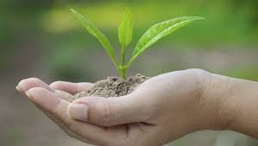
Organic farming helps farmer in adoption of climate change
As it increases :
Micro organism & Micro nutrients in the soil.
Earth worms in the soil.
Humus in the soil.
soil structure & texture.
Beneficial insects.
Water holding capacity of soil.
Vegetation on the land.
Vegetative cover in the area.
Influence of Organic Farming

Slide 15
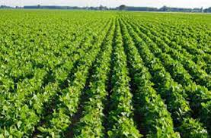
Recommendation of regional workshops
Farmers must adopt traditional practices of preparation of soil & seed bed.
Priority to Soil & water conservation.
Use of organic manure only.
Use of early verities of crops.
Use of organic seeds.
Use of organic preparations only with proper time frame.
Never use chemicals in crop production.
Promote cash crop .
Influence of Organic Farming

Slide 16
Recommendation of regional workshops
Animal husbandry must be included compulsorily (at least 1 cow per Bigha).
Govt. have to support organic farming on priority basis.
Govt. have to promote & support organic market & price of organic produce.
Thanks
Influence of Organic Farming

